Slide 1


Unraveling Media Impact –
Bayesian and Frequentist Approaches to Media Mix Modeling
SURI CHEN
Principal Data Scientist @PepsiCo
06/08/2023

Slide 2













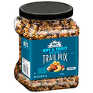


CUSTOMERS
BRANDS
FUNCTIONS
sales
supply chain
finance
marketing
DTX - Data Technology & Experience

Slide 3
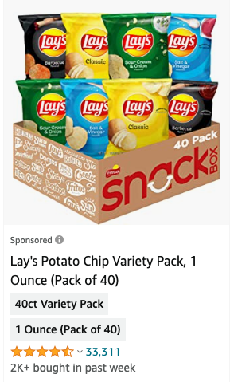

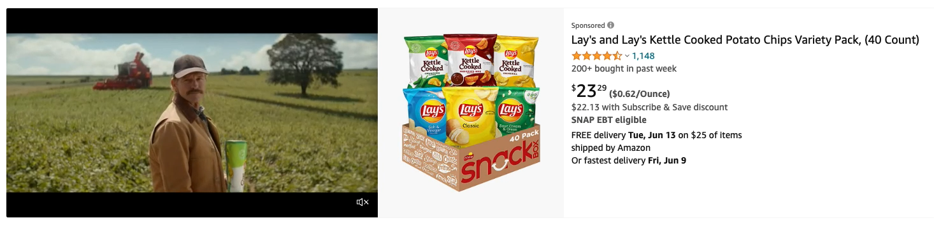
Marketing Strategy
SPONSORED SEARCH
BANNER & SPONSORED BRAND
85%
DISPLAY ADS

Slide 4
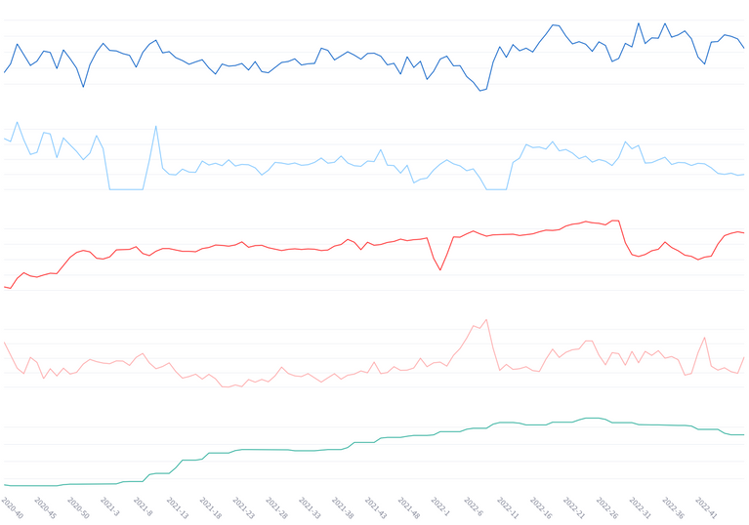

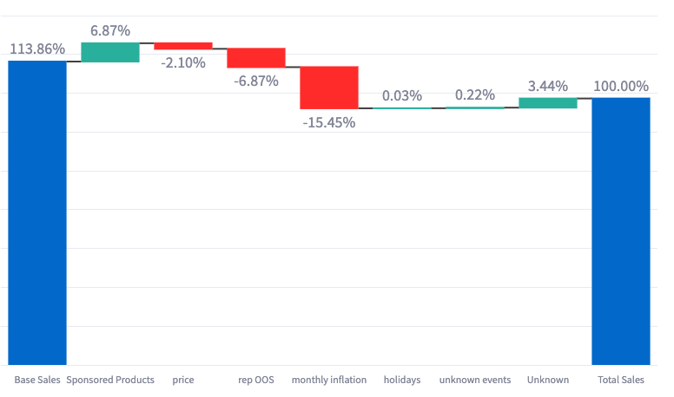
Problems
Understanding the impact of various digital marketing investments and micro or macro economics factors on sales
Optimal Budget Allocation
Sales Driver
Predictive Analytics
How different parts of business driving sales and how much they contribute to the total sales
where to invest their budget for maximum effectiveness. Identify which digital channels provide the best return on investment. Pinpoint areas for improvement to increase total sales.
Predict future outcomes based on various investment scenarios. Should we invest more on sponsored search or promotion? What if we stop spending?

Slide 5
Solutions
Casual or Correlation Analysis
EXPERIMENTS
Causal or Correlation Analysis
Randomized Experiments
Causal Inference
Attribution Model
MMM - Marketing Mix Modeling
A/B Testing
Opt-in / One - click experiments

Slide 6




What is MMM
Total Available Market (TAM)
Marketing Mix Modeling (MMM) is a statistical technique that quantifies the impact of various marketing inputs on sales or other performance metrics
Mathematically, this is done by establishing a correlation analysis of various marketing activities and other external factors with the sales, in the form of a linear or a non-linear equation, through the statistical technique of regression.
Total Sales = Base Sales + Incremental Sales
Marketing + Price + Supply Chain + Economics
Notes:
MMMs use aggregate historical time series data to model sales outcomes over time, as a function of advertising variables, other marketing variables, and control variables like weather, seasonality, and market competition.
Marketing-mix models decompose total sales into two components:

Slide 7
Why MMM
Randomized Experiments
Multiple experiments to test the hypothesis for different level
Technical hurdles in implementations
Weak Advertisement effects require large sample sizes
Lost opportunity costs from having a control group
Causal Questions
Control selection bias to produce meaningful casual results
Data points usually are limited for a typical MMM scenario
Difficult to match control variables to conduct casual inference
Potential Outcomes Analysis
Notes:
Gold standard is to conduct a randomized experiment, which can be carried out at different level
A randomized experiment answers the question of what will happen if an advertiser did action X, by randomly splitting a population into a test group, where the action X is performed and a control group, where no action is taken.

Slide 8
How to build a Marketing Mix Model
Sales = Trend + Seasonality + Marketing Spends + Price + Out Of Stock + Macro Economics
Base Sales
Incremental Sales
Linear Regression
*Non - linear Regression
*Sun, Yunting et al. “Geo-level Bayesian Hierarchical Media Mix Modeling.” (2017).

Slide 9
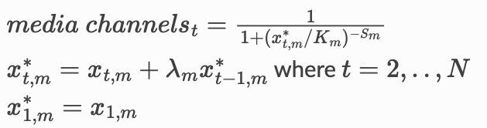
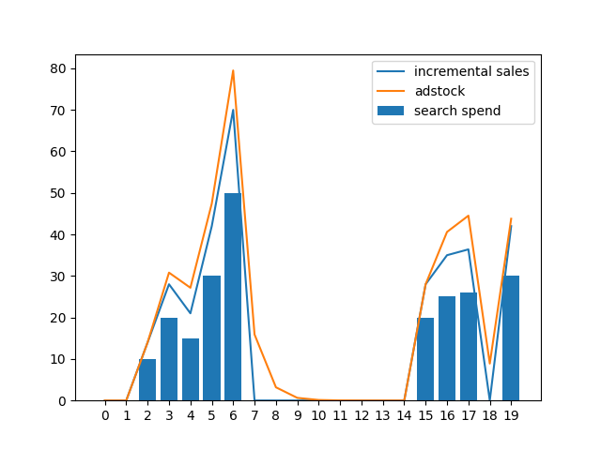
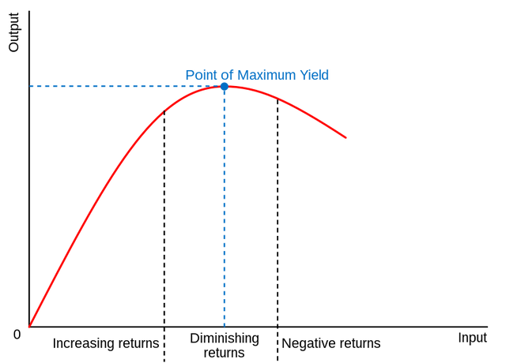
How to build a Marketing Mix Model
Non - linear Regression
*Sun, Yunting et al. “Geo-level Bayesian Hierarchical Media Mix Modeling.” (2017).

Slide 10
How to learn a Marketing Mix Model
Frequentist Approach
Bayesian Approach
Interprets probability as the long-run frequency of events
Unknown parameters are considered fixed values.
Data is seen as random because it changes each time you collect a new sample.
Provide point estimates on parameters
Interprets probability as a measure of belief or confidence
Unknown parameters are treated as random variables.
Uses prior knowledge or belief, which is updated as more data is collected.
Provide a probability distribution on parameters

Slide 11
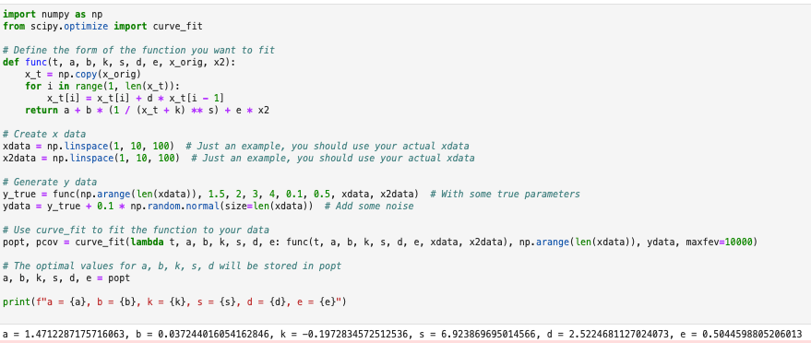
Learning MMM
Frequentist Approach
Implementation Example
Challenges
Absence of a closed-form solution, necessitating iterative methods
Dependence on initial parameter guess, with different starting points potentially leading to different results
Risk of non-convergence or convergence to non-optimal solutions
Requirement of extensive hyperparameter tuning for optimal performance
Notes:
also worth to mention that the data points we are facing are limited, which makes the learning insufficient

Slide 12
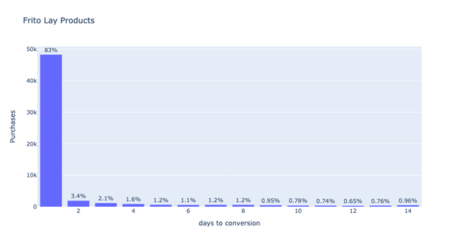
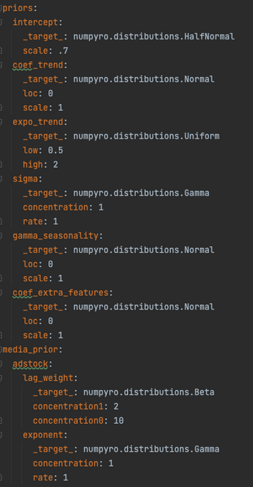
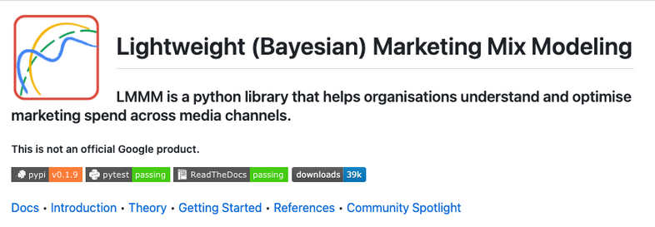
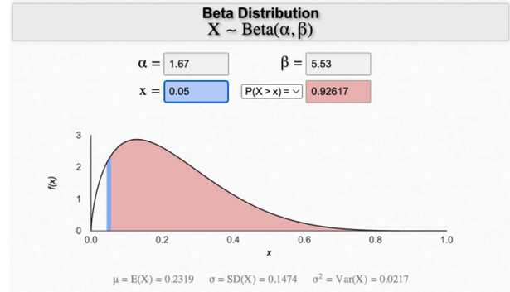


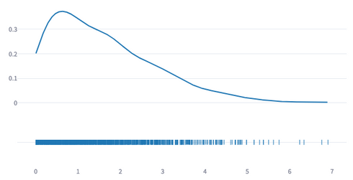
Learning MMM
Bayesian Approach
Implementation
Ad stock effects
Media Coefficients
JAX
NumPyro
Notes:
priors will influence the results and

Slide 13
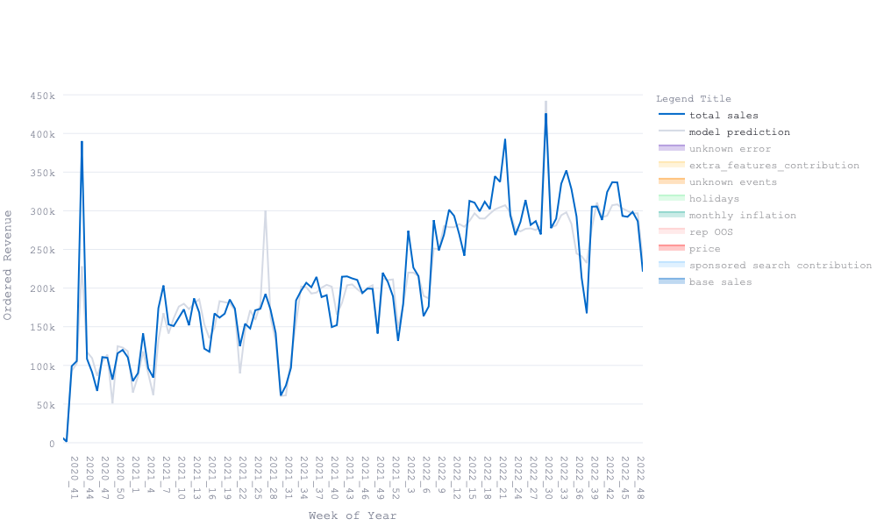
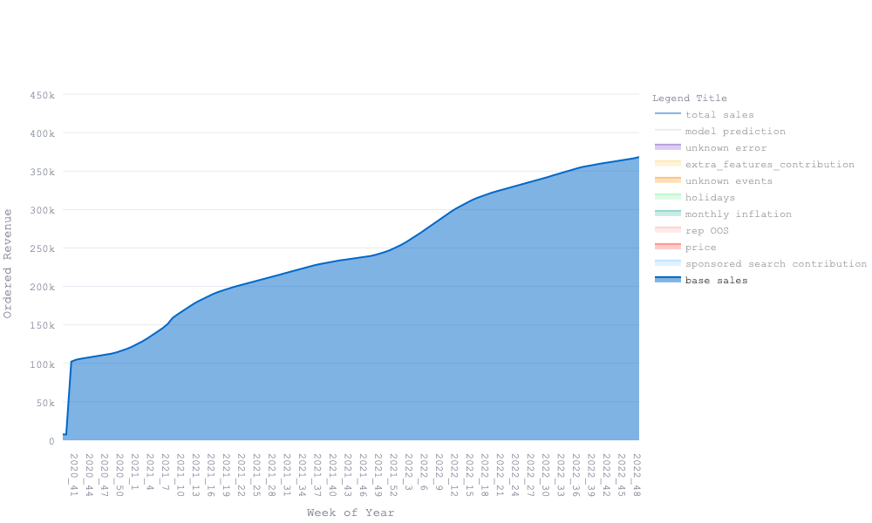
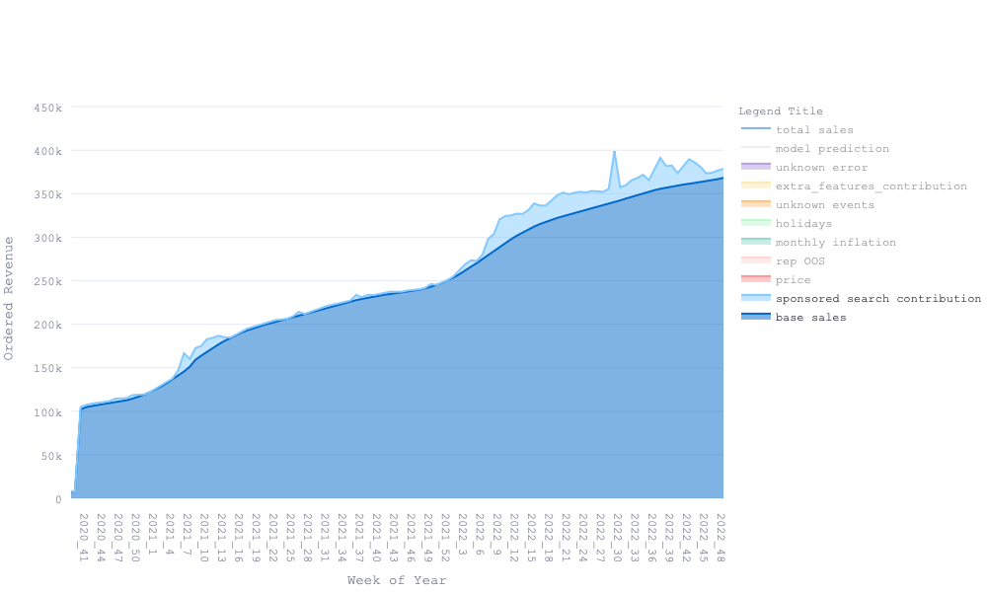

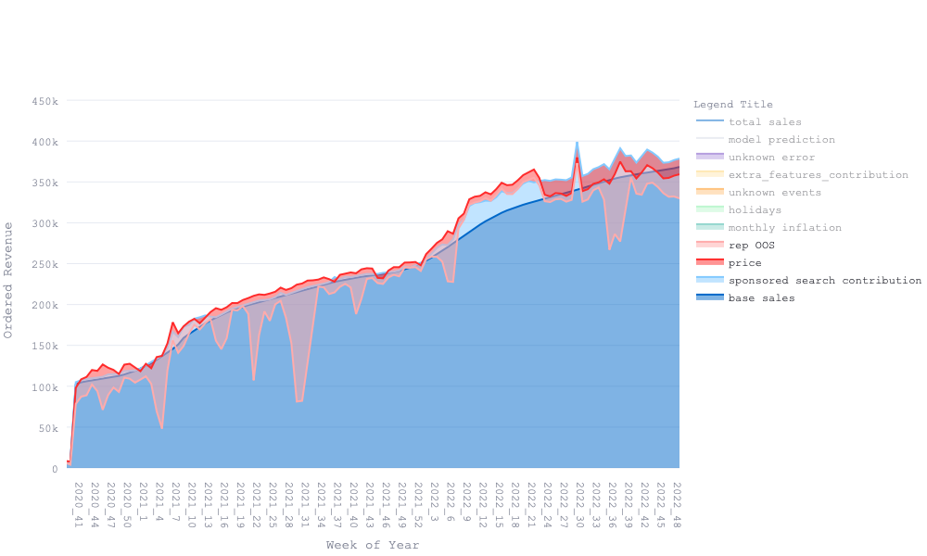
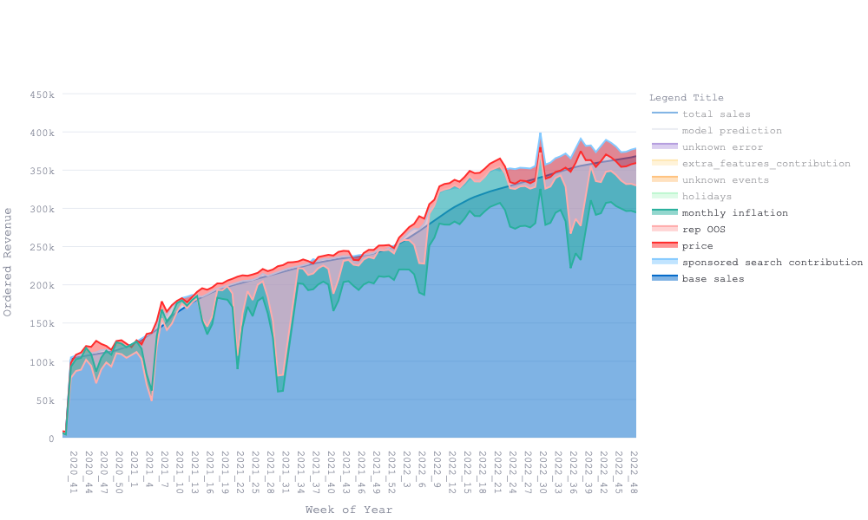

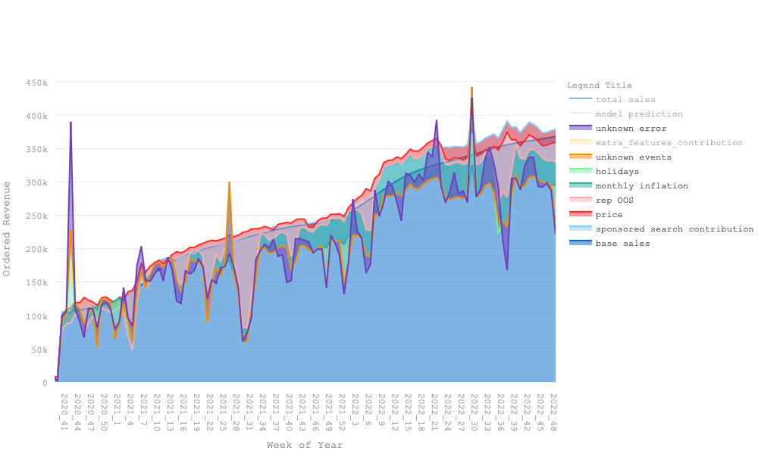
What did we learn
Notes:
Please add graphs

Slide 14

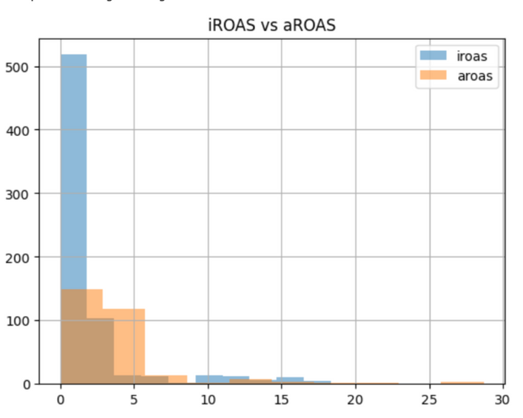

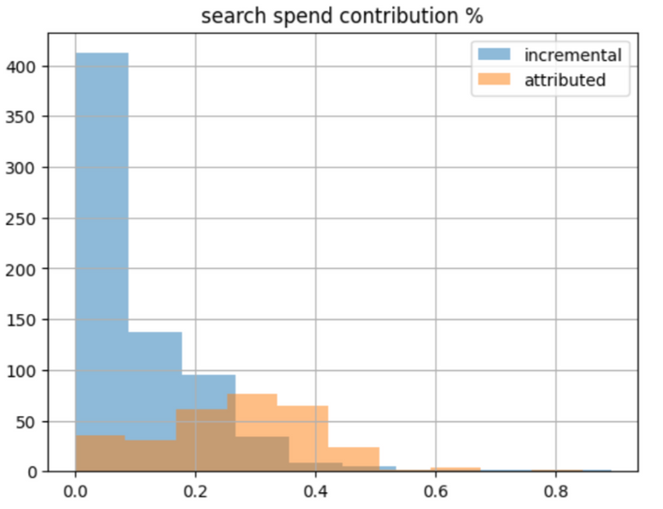

What did we learn
attributed ROAS AND incremental ROAS comparison
attributed
ROAS
2.81
1.91
attributed
Contribution
24.9%
12.84%
incremental
Contribution
incremental
ROAS
Reporting Metrics should be treated as organic sales
Optimization

Slide 15
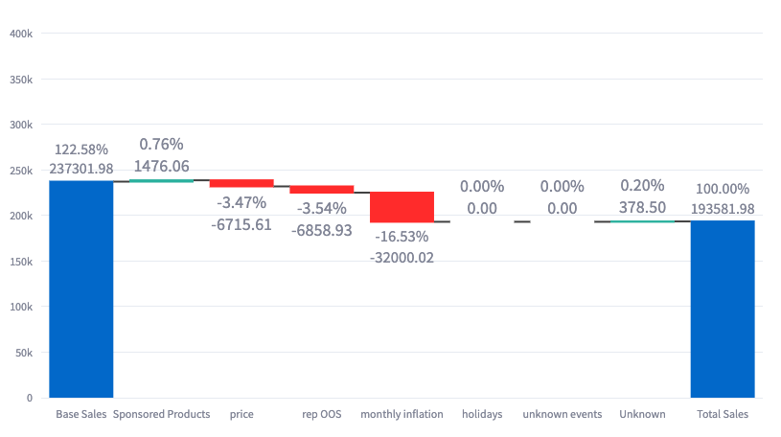
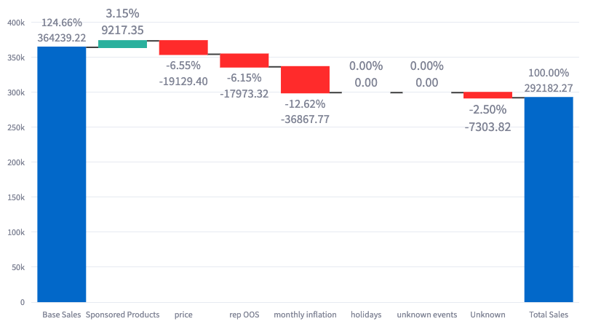


What did we learn
Due-to Analysis
2021 week 45
2022 week 45
Total Sales
Base Sales
Sponsored Search Contribution
Price Impacts
Out Of Stock Impacts
Inflation Impacts
Total Sales
Base Sales
Sponsored Search Contribution
Price Impacts
Out of Stock Impacts
Inflation Rate Impacts
106,282
126,937
7,741
12,413
11,114
4,867
55%
+ 119%
+ 7%
- 12%
- 10%
- 4%

Slide 16
Could we make it better?

Slide 17
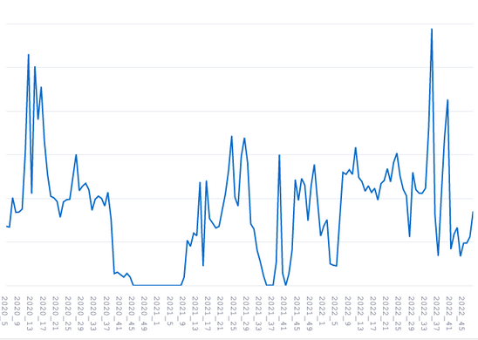
Increasing Explainability
Feature Scaling: the optimal baselines for model interpretation.
Outlier Management: Improve baseline learning
Stock-out
Unforeseen sales spikes
Consumer Behavior: Gain insights into consumer response to changes in pricing.
Economic Influences: Develop strategies based on the interpretation of macroeconomic impacts.
Non-Linear Dynamics: Understand the non-linear impacts stemming from different factors.
Notes:
We focused on model implementation, but there was a very important step before model training is Features scaling.

Slide 18
Our Insights
Frequentist approach: swift and simple; Bayesian approach: utilizes prior knowledge, good for small data.
In MMM, explainability is key, and feature engineering boosts it.
MMM's application is an iterative process, demanding close collaboration between data scientists and business stakeholders for the optimal outcome.
Notes:
While the frequentist approach provides a quick and straightforward method to decipher data patterns, the Bayesian approach enables us to leverage prior knowledge and perform well even with limited datasets.
MMM's effectiveness is tied to its interpretability. Feature engineering serves as an instrumental tool in enhancing model's explainability.'
MMM should be viewed as an ongoing learning journey rather than a one-time solution. It requires a strong collaboration between data scientists and business stakeholders for continued success and refinement.

Slide 19
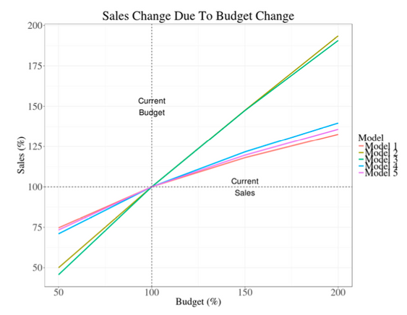

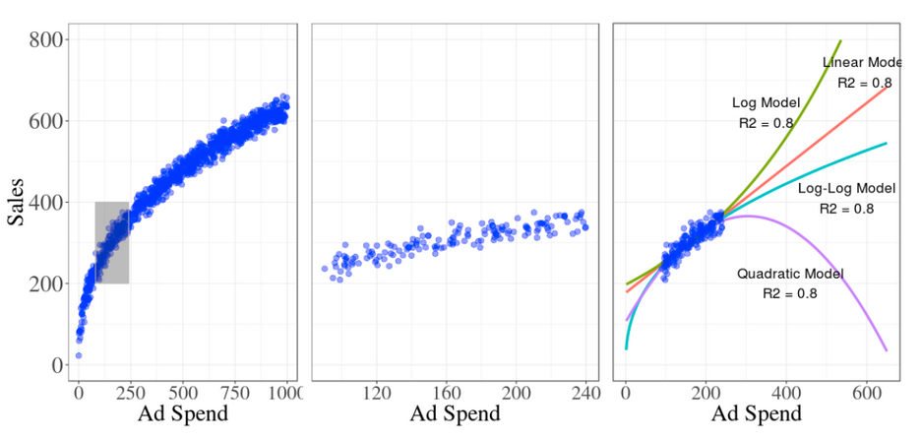
Model Uncertainty
Other Challenges
MMM
Limited data range
Model
Feedback & Validation
Predictions
Measurements
Hypothesis
Source: Chan, David and Mike Perry. “Challenges and Opportunities in Media Mix Modeling.” (2017).

Slide 20
Thank You
Suri Chen
https://www.linkedin.com/in/suri-chen/

